Slide 1

A PROPOSED GRAND STRATEGY FOR THE UNITED STATES
William Bradford
Presentation to American University School of Public Policy, 11 June 2013

Slide 2
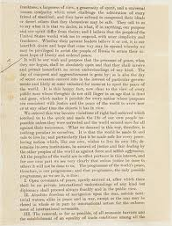
14 Point Grand Strategy for Victory in the Global War on Terror
Define the Sphere of Freedom and the Vital Interests
Restore the Concept of the Enemy
Define the Goal(s)
Secure the Border
Eliminate the Internal Threat
Craft Layered Defenses
Fight the Battle Over There
Use ASD/Preventive War
Create New Collective Security Institutions/
Spheres of Influence
Use Tailored/Economical Force
Wage Contra Barbarum
Wage INFOWAR
Trigger Protestant Reformation in Islam
Achieve Limited Government, Strengthened Thumos, Self Sufficiency

Slide 3

Define the Sphere of Freedom and Vital Interests
capitalism
common law
constitutionalism
republican virtues
natural law
democratic institutions
free trade
liberal, secular governance

Slide 4
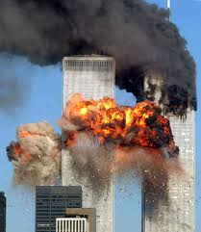
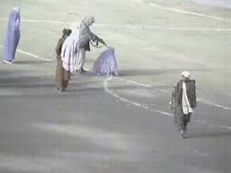

Restore the Concept of the Enemy
Restore the Concept of the Enemy
Define the Enemy
General Mobilization

Slide 5
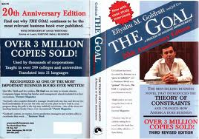

Define the Goal
Differentiate Goal from Strategies from Operations from Tactics
Kill or Capture All Islamists?
Win All Hearts and Minds?
Reformation within Islam?
Deterrence/Dissuasion
Beware the Shell Game

Slide 6
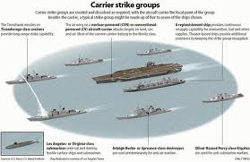
Craft Layered Defenses
Premised on CBG doctrine
Concentric circles, highest value at center
CONUS is carrier, allies are pickets, other instruments of power (diplomacy, intelligence, etc.) are subs

Slide 7
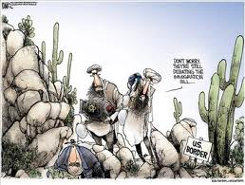
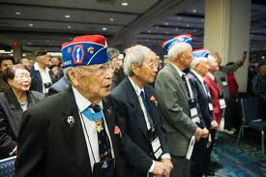
Assay/Reduce Internal Threat
Securitize border
Ensure those present are not allied to hostile actors
Encourage domestic Muslims to follow in path of Japanese-Americans during WWII

Slide 8
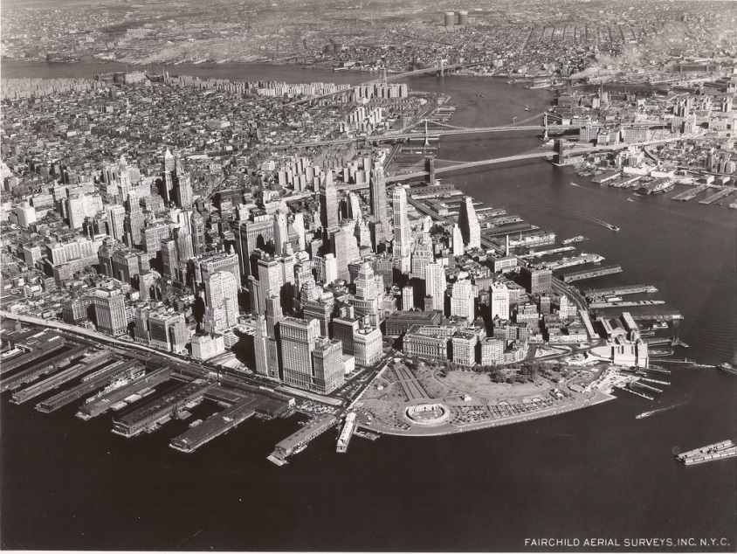
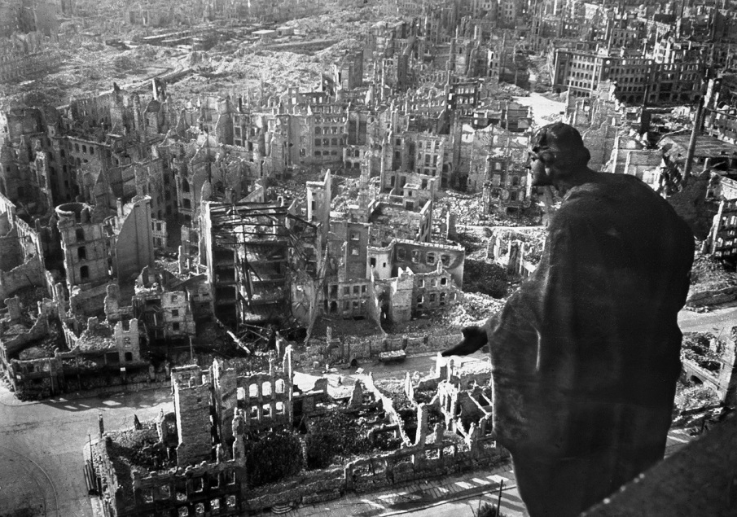
Fight Over There
Less collateral damage to American interests
Induces indigenous pressure to abandon campaign

Slide 9
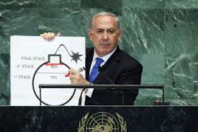

Anticipatory Self-Defense
Not wait until attacked to return fire
Requires vigorous legal and diplomatic campaigns
Necessitates sharing intelligence
Political risk

Slide 10
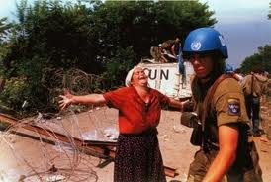
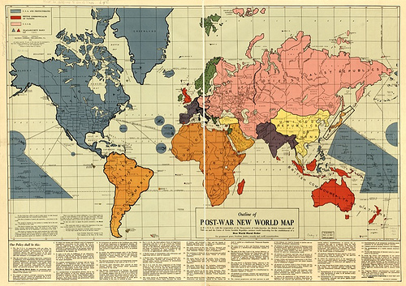
Create New Collective Security Institutions/Spheres of Influence
UN is broken: Chapter VII unenforceable, formal equality of states promotes mischief, Security Council politicized
No money to go it alone
Like-Minded coalitions of able and willing exist
Churchill’s Great Powers spheres-of-influence may be more effective, cheaper, and more consistent with regional HR norms

Slide 11
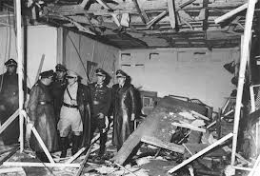
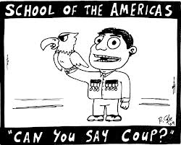
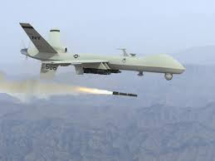
Use Tailored/Economical Force
Counterregime: economical, little collateral damage (Hitler 1938, Saddam 1990, ?)
Assassination: lawful if head of state is head of armed forces
Covert ops: supports indigenization strategy
Proxies: saves U.S. lives, treasure
Technology: comparative advantage

Slide 12

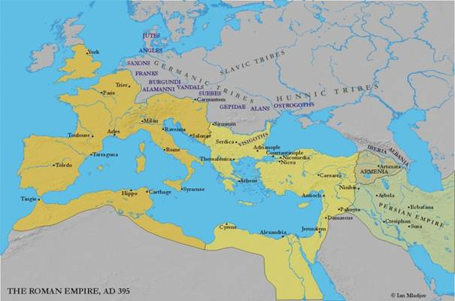
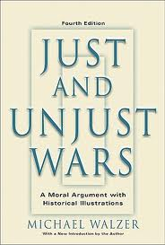
Contra Barbarum
Resurrect Greco/Roman and common-law distinction
Link ad bellum/in bello: Just War v. Unjust War
Suspend in bello protection

Slide 13

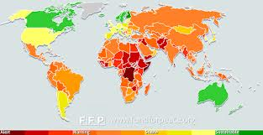

Wage INFOWAR
Fight legal revisionism
Failed/rogue states no longer formal equals
Strategic messaging through media like Radio Sawa, al Hurra) and intel sharing with allies

Slide 14
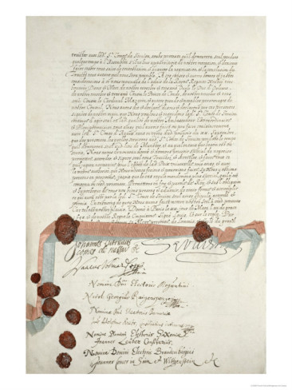
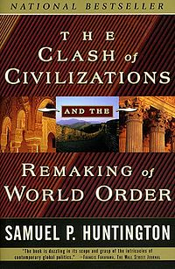
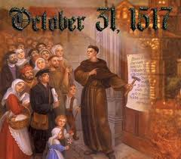
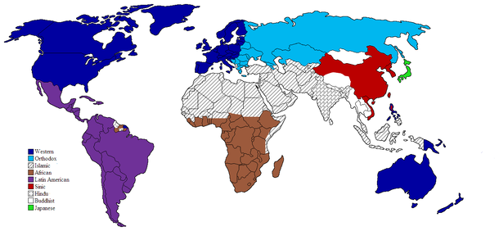
Trigger Protestant Reformation in Islam
Ended religion as cause of war in West in 17th century
Would end existential conflict
May require Islamic civil war, which would turn energies inward

Slide 15
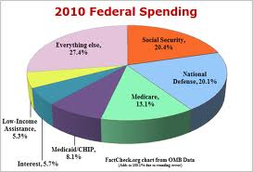
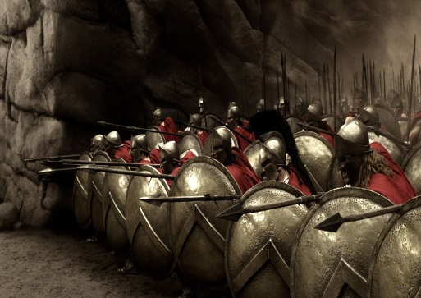


Achieve Limited Government, Strengthen Thumos, Become Self-Sufficient
Reduce financial vulnerability, particularly on nonfriendly powers
Strengthen thumos, civism
Resource self-sufficiency
Support every strategy and the goal

Slide 16
Questions?
Prof. William Bradford
Law/Government Sections
United States Coast Guard Academy
15 Mohegan Avenue
New London, CT 06320
(703) 517-5719
William.bradford@post.harvard.edu

